Slide 1
Op-Amps (İşlemsel Yükselticiler)
Definition:
Circuits that amplify the voltage, current, or power by maintaining the weak input signal's basic waveform characteristics of the signal.

Slide 2
Op-Amps perform mathematical operations on the input signal: -Addition subtraction, multiplication and division -Derivation and Integration… Op-Amps Circuits are used: -In Radio and TV receivers -In Medical Research and Diagnostic Devices -InTechnical Measurement and Different Electronic Devices -In Active Filters -In Active Control Circuits -In Analog-Digital Interfaces

Slide 3
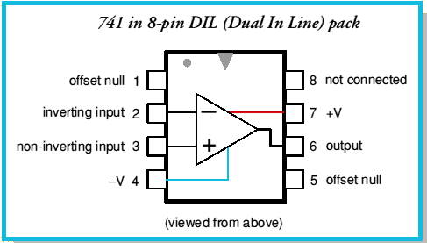
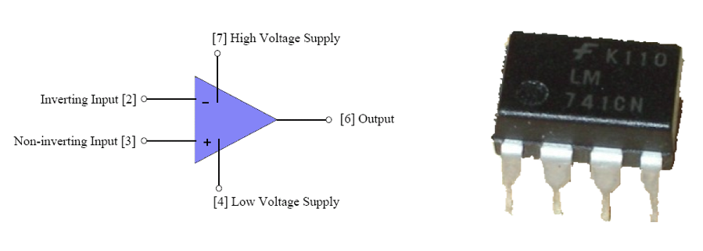
Appearance
It is in the form of a compact structure with the appearance of a closed black box.
Usually 8 connections (pins), but 5 of the connections are most often used.
Pins start at 1 and are numbered incrementally.

Slide 4
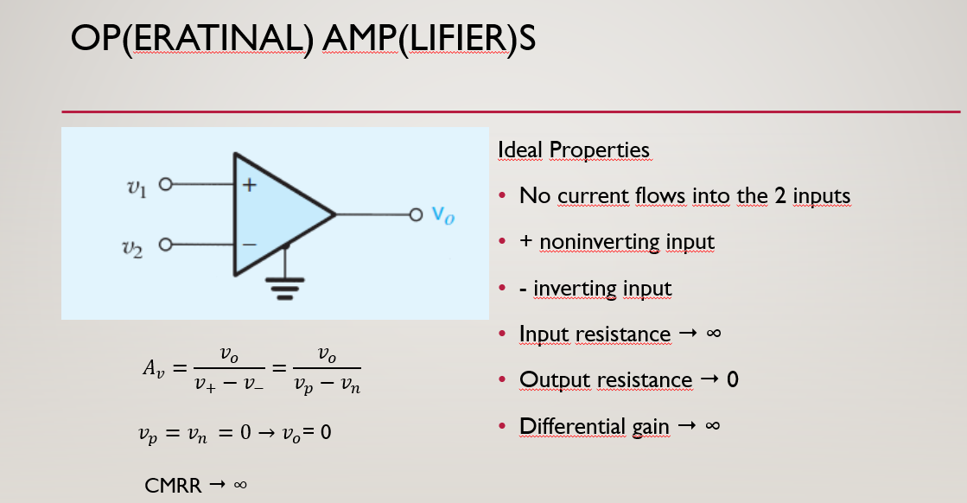

Slide 5
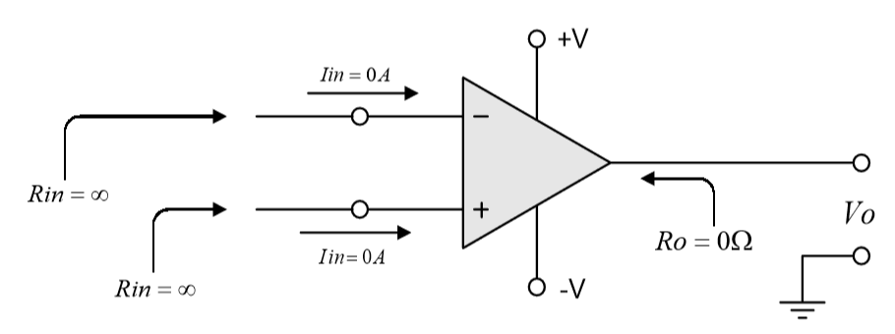
OPERATIONAL AMPLIFIERS

Slide 6
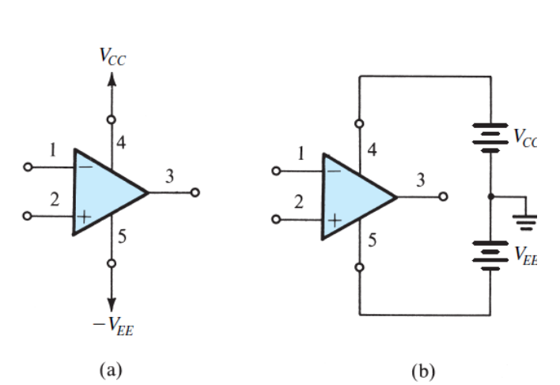
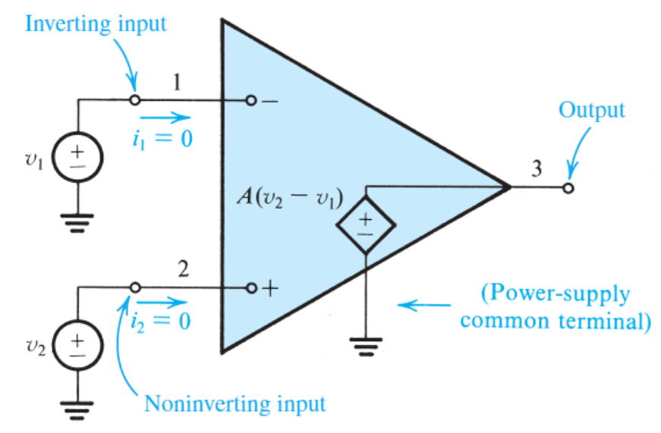
OPERATIONAL AMPLIFIERS

Slide 7
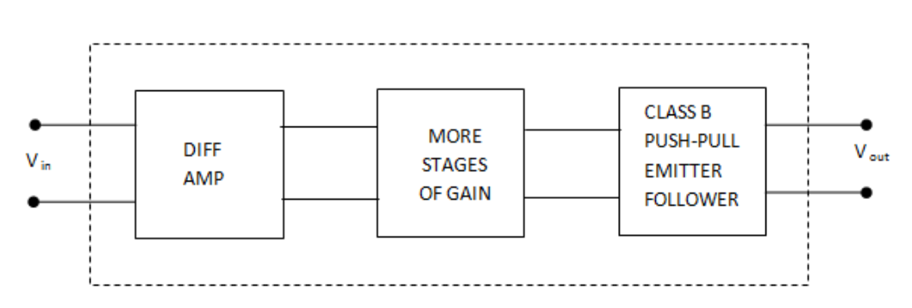
Block Diagram of OPAMP

Slide 8
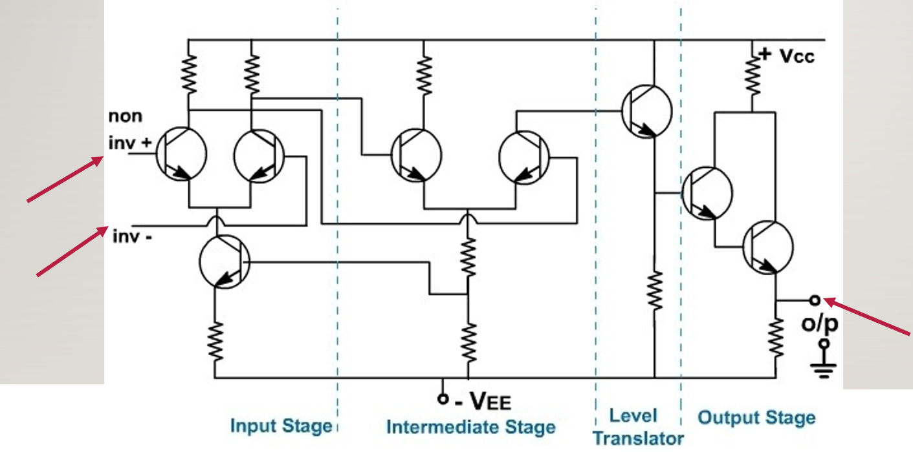
WHAT IS IN an OPAMP

Slide 9
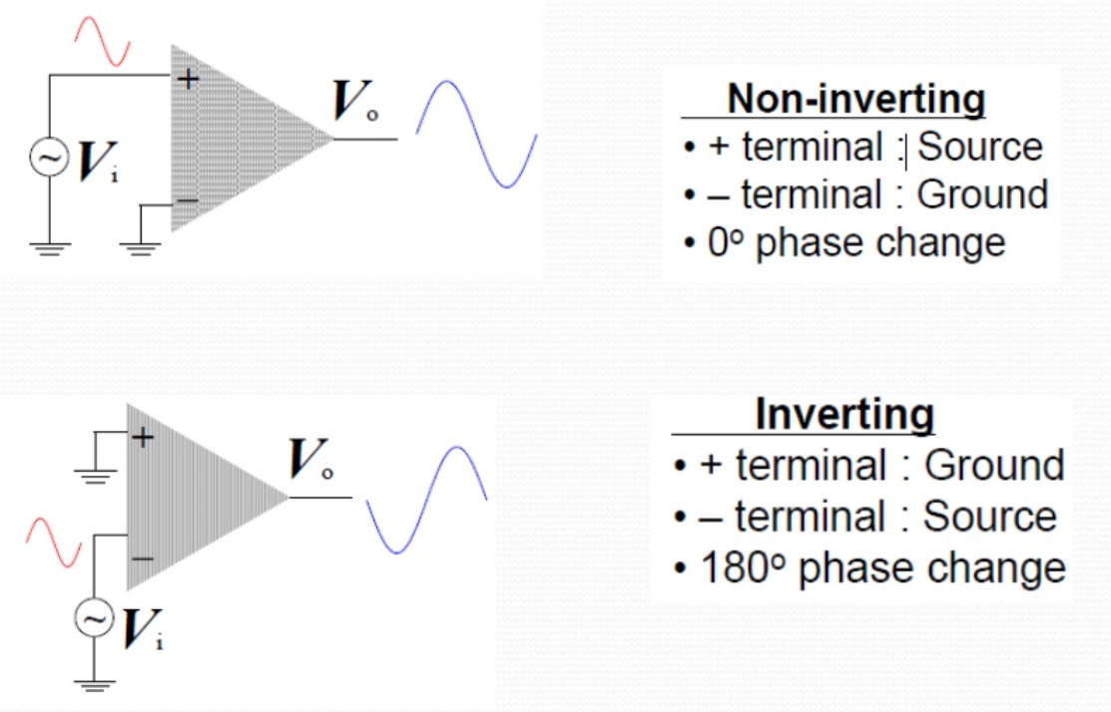

Slide 10
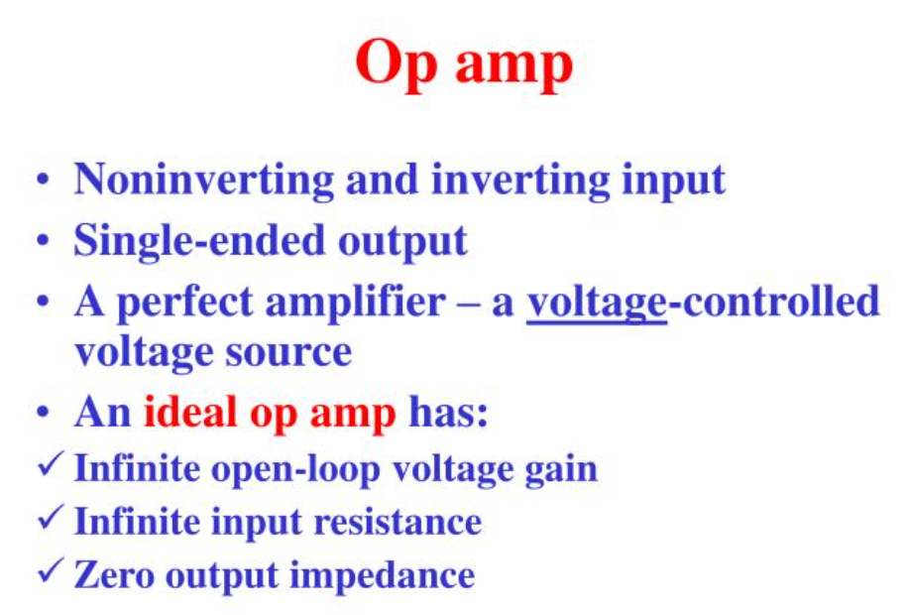

Slide 11
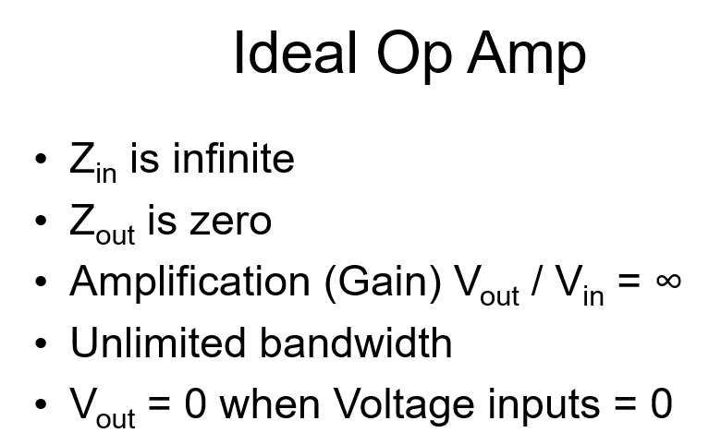

Slide 12
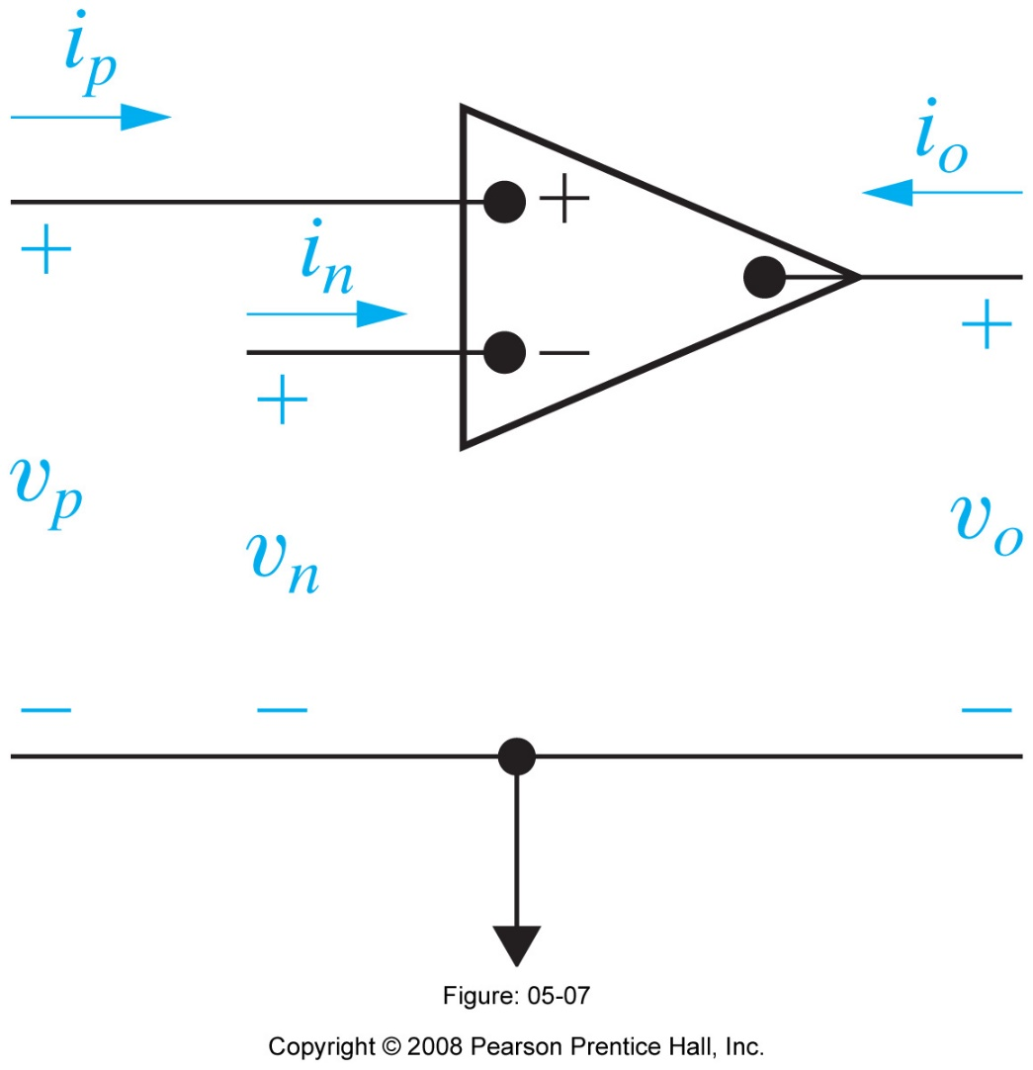
Ideal OP AMP (Open Loop)
A = “open-loop” gain
A

Slide 13
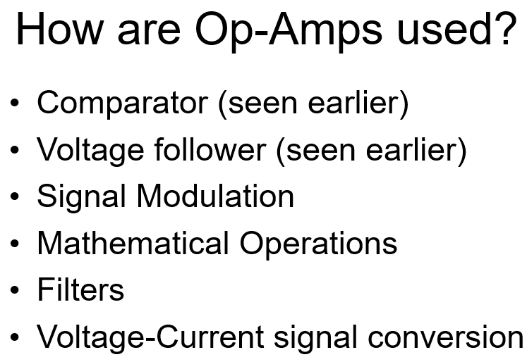

Slide 14
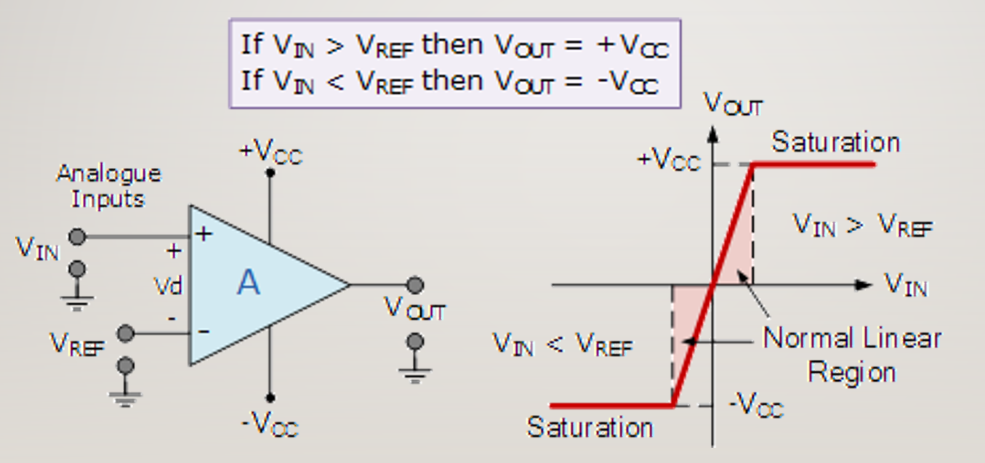
Open loop use – opamp as comparator

Slide 15
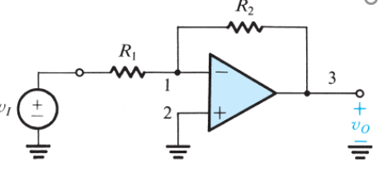
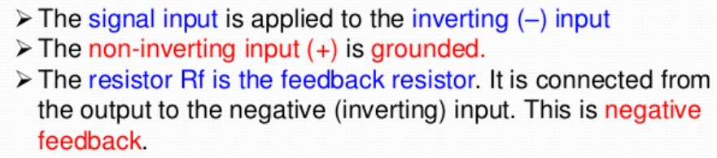
Closed loop use – several desıgns
Inverting closed loop configuration

Slide 16
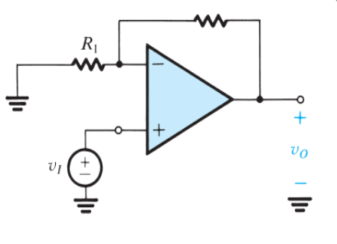
Non- inverting closed loop configuration
R2

Slide 17
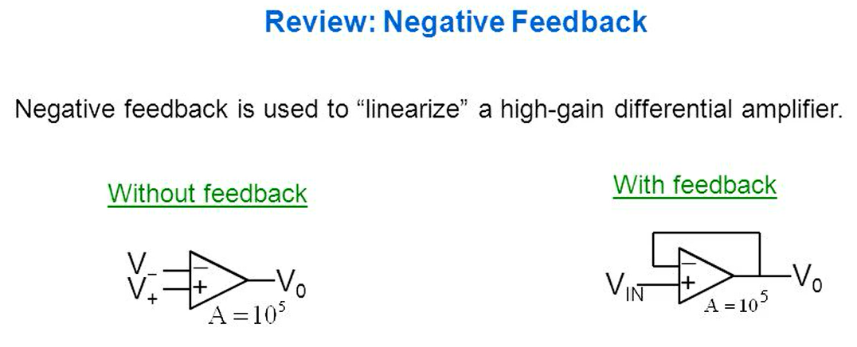
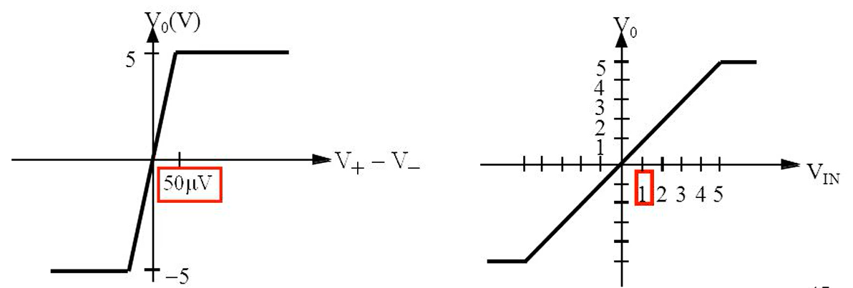

Slide 18
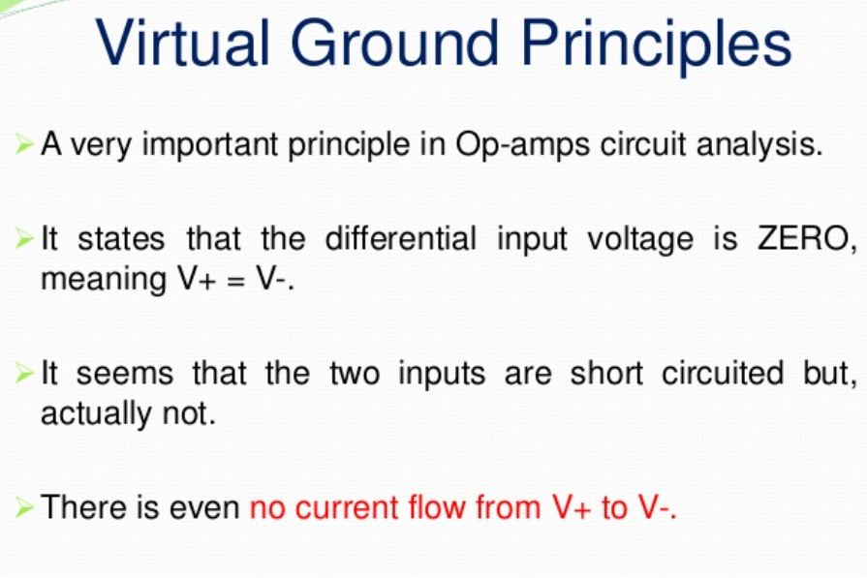

Slide 19
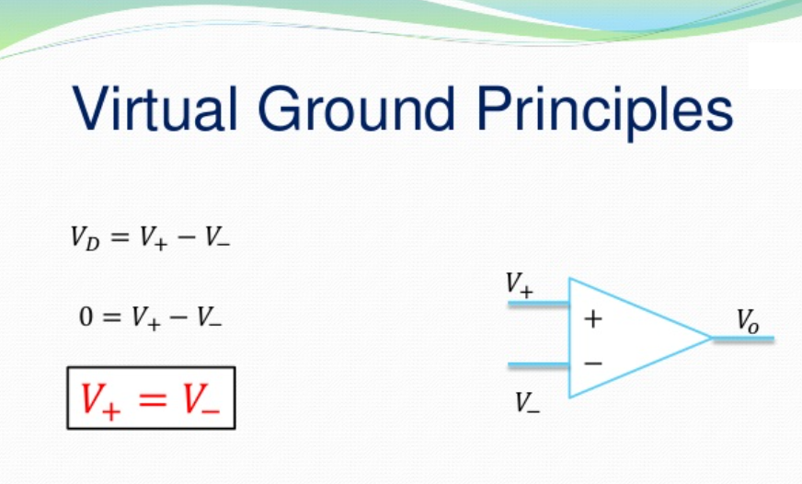

Slide 20
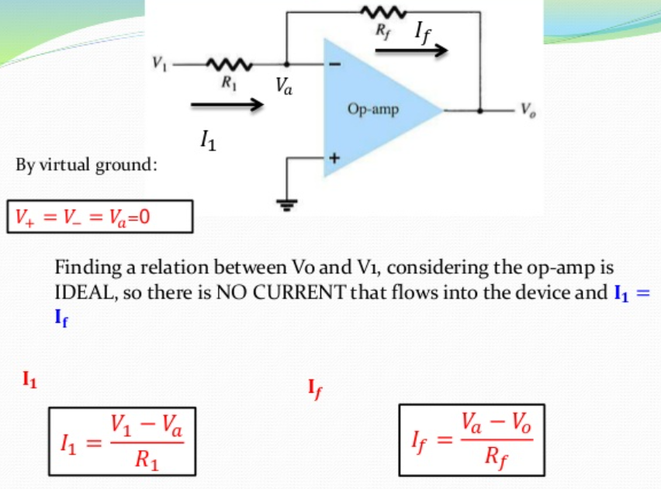

Slide 21
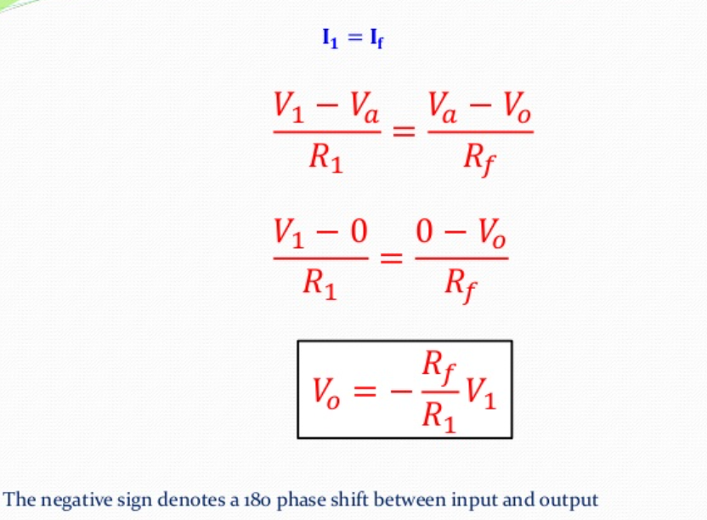

Slide 22

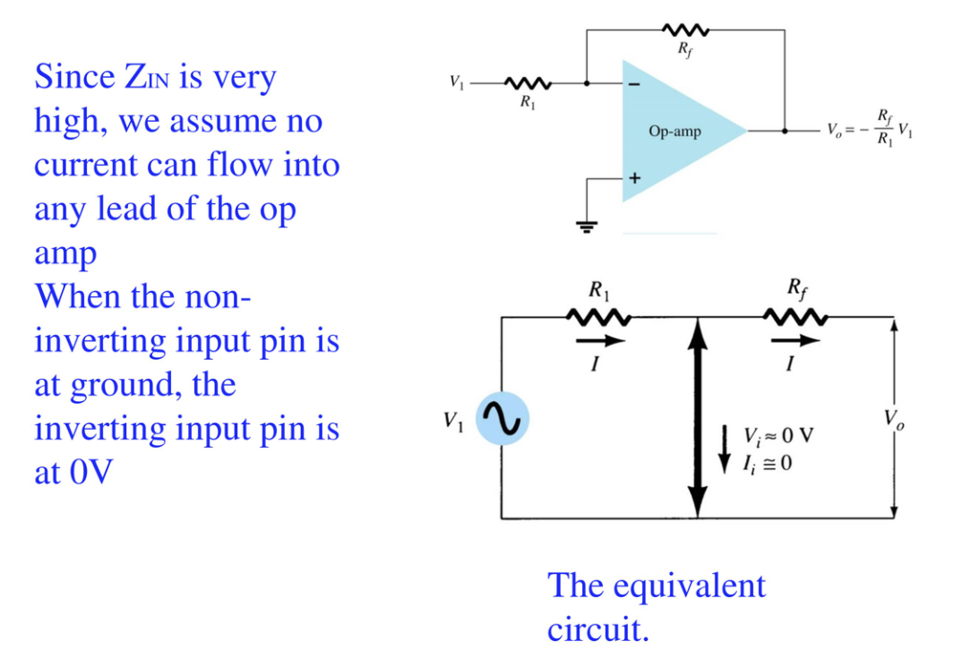

Slide 23
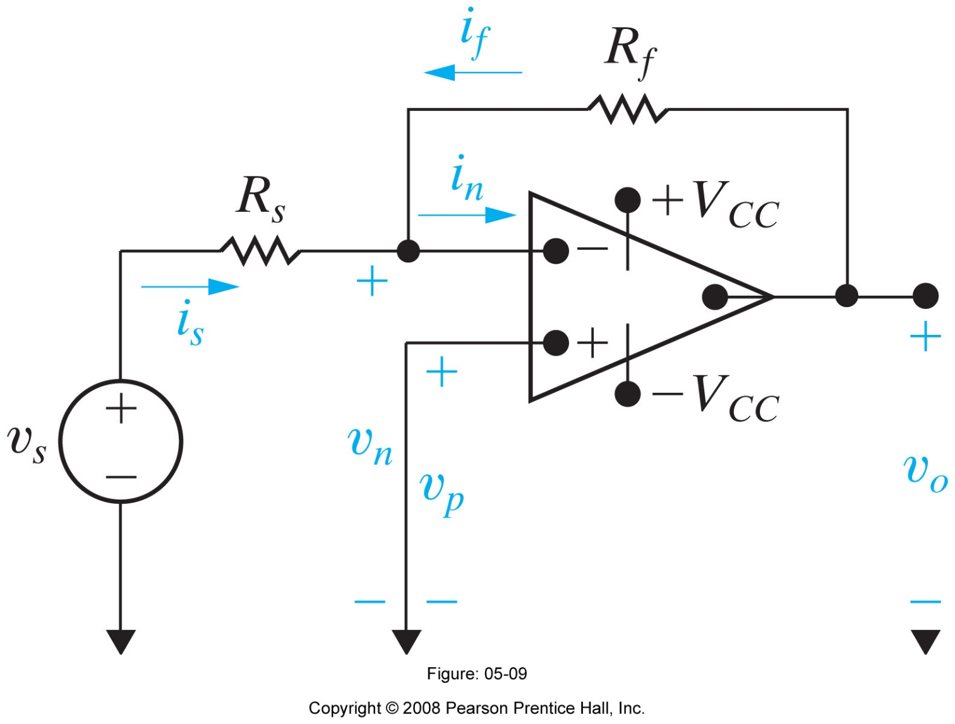
Inverting Amplifier

Slide 24

Analysis Using the Ideal OP AMP
“Virtual” ground

Slide 25
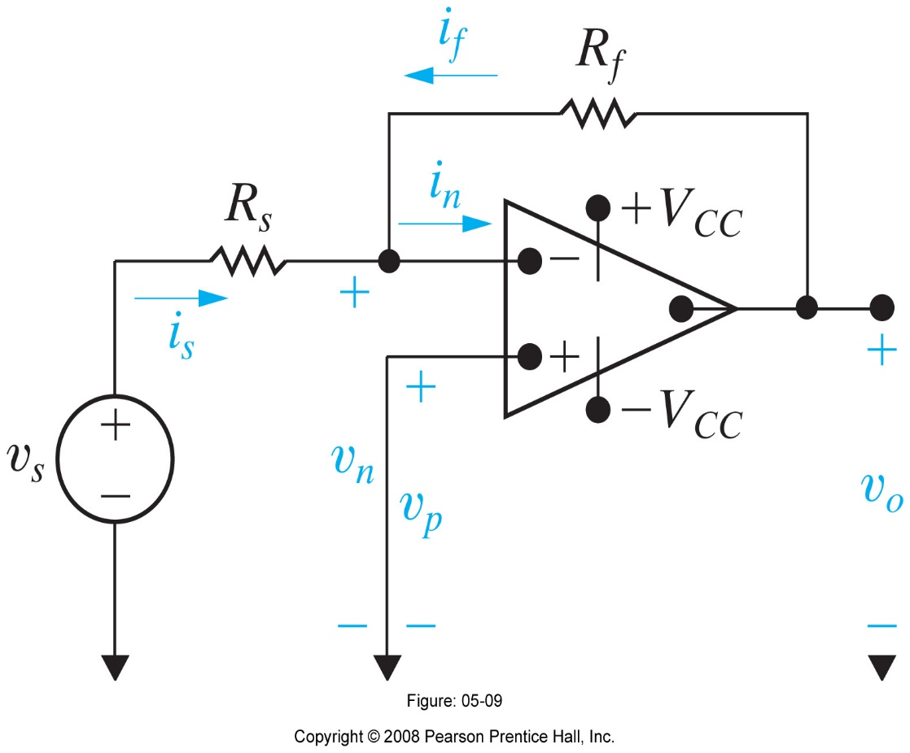
Analysis continued

Slide 26
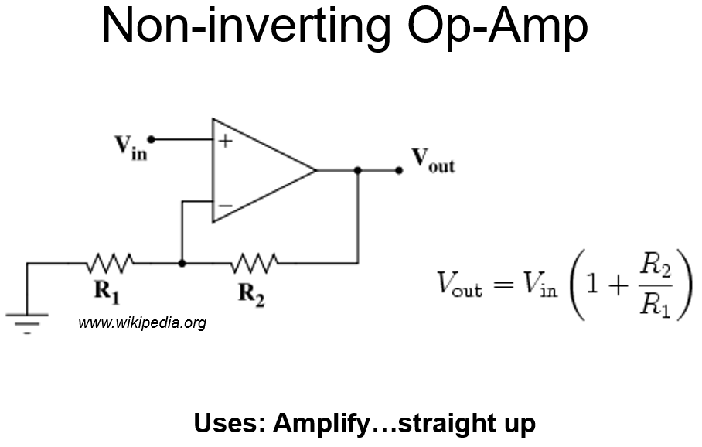

Slide 27
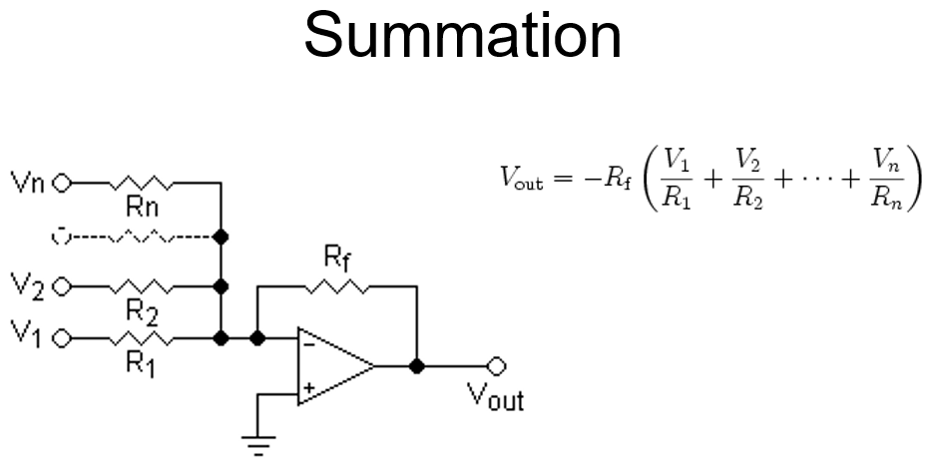

Slide 28
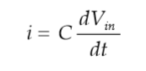

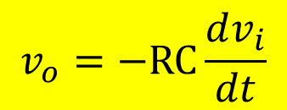
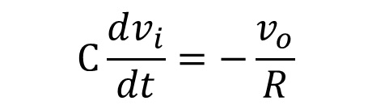
Invertıng Differentiator (low pass filter)
$$i=\frac{−v_{0}}{R}$$
Combining the 2 Eq.s
$$C\frac{dv_{i}}{dt}=−\frac{v_{o}}{R}$$
$$v_{o}=−RC\frac{dv_{i}}{dt}$$
and thus

Slide 29
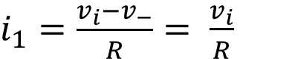
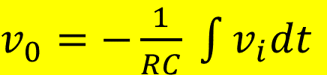
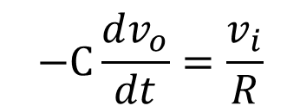
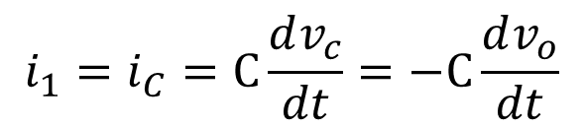
Integrating Opamap
$i_{1}=\frac{v_{i}−v_{−}}{R}= \frac{v_{i}}{R}$
$$i_{1}=i_{C}=C\frac{dv_{c}}{dt}=−C\frac{dv_{o}}{dt}$$
Combining the 2 Eq.s and integrating
$$−C\frac{dv_{o}}{dt}=\frac{v_{i}}{R}$$
$v_{0}=−\frac{1}{RC} \int{v_{i}dt}$

Slide 30
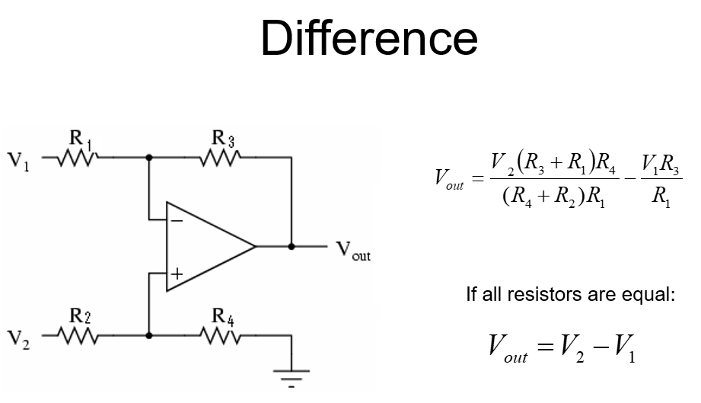

Slide 31
Gerilim İzleyici (Voltage Follower)
The output of the op amp is provided by giving it to the (-) end of the input without any feedback resistance (Rf).
A=1
V_{in}=V_{out}
It acts as a buffer that separates the input signal from the load.
High input resistance
Output resistance is small
V–
–
V_{output}
V_{in}
+

Slide 32
A superıor desıgn – ınstrumentatıon amp

Slide 33
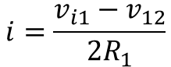
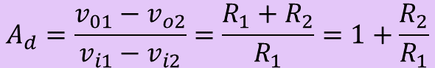
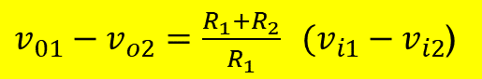
Instrumentatıon amp – fırst stage
$v_{01}−v_{o2}=2i\left(R_{1}+R_{2}\right)$= 2 $\frac{v_{i1}−v_{12}}{{2R}_{1}}$ $\left(R_{1}+R_{2}\right)$
$$i=\frac{v_{i1}−v_{12}}{{2R}_{1}}$$
$v_{01}−v_{o2}=\frac{R_{1}+R_{2}}{R_{1}} (v_{i1}−v_{i2}$)
$$A_{d}=\frac{v_{01}−v_{o2}}{v_{i1}−v_{i2}}=\frac{R_{1}+R_{2}}{R_{1}}=1+\frac{R_{2}}{R_{1}}$$

Slide 34
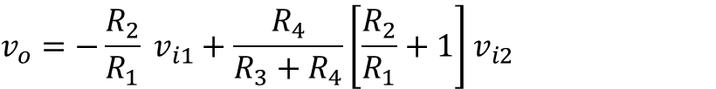
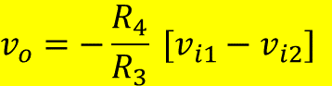
Instrumentatıon amp – second stage
$$v_{o}=−\frac{R_{2}}{R_{1}} v_{i1}+\frac{R_{4}}{R_{3}+R_{4}}\left[\frac{R_{2}}{R_{1}}+1\right]v_{i2}$$
Taking symmetric values for R₁ and R₂, i.e.
R₁ = R₃ and R₂ = R₄
$$v_{o}=−\frac{R_{4}}{R_{3}} [v_{i1}−v_{i2}]$$

Slide 35
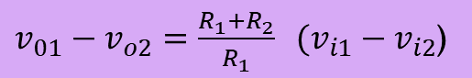
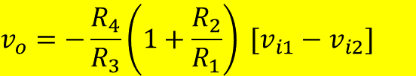
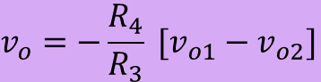
Instrumentatıon amp – both stages
$$v_{o}=−\frac{R_{4}}{R_{3}}\left(1+\frac{R_{2}}{R_{1}}\right) [v_{i1}−v_{i2}]$$
$v_{01}−v_{o2}=\frac{R_{1}+R_{2}}{R_{1}} (v_{i1}−v_{i2}$)
$$v_{o}=−\frac{R_{4}}{R_{3}} [v_{o1}−v_{o2}]$$

Slide 36
